Slide 1
Lecture 6
The Level Set Approach for Turbulent Premixed Combustion: Introduction
12.-1

Slide 2
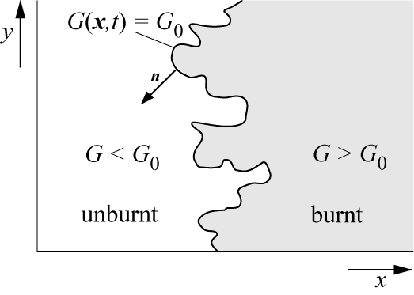

A model for premixed turbulent combustion, based on the non-reacting scalar G
rather than on the progress variable, has been developed in recent years.
It avoids complications associated with counter-gradient diffusion and, since G is non-reacting, there is no need for a source term closure.
An equation for G can be derived
by considering an iso-scalar surface
This surface divides the flow field into
two regions where
G > G₀ is the region of burnt gas
and
G < G₀ is that of the unburnt mixture.
The choice of G₀ is arbitrary, but fixed for a particular combustion event.
12.-2

Slide 3
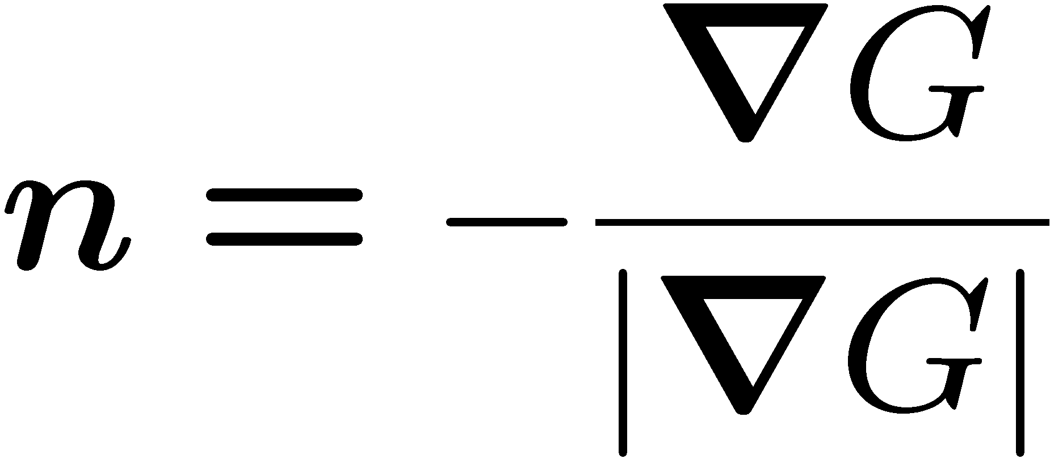
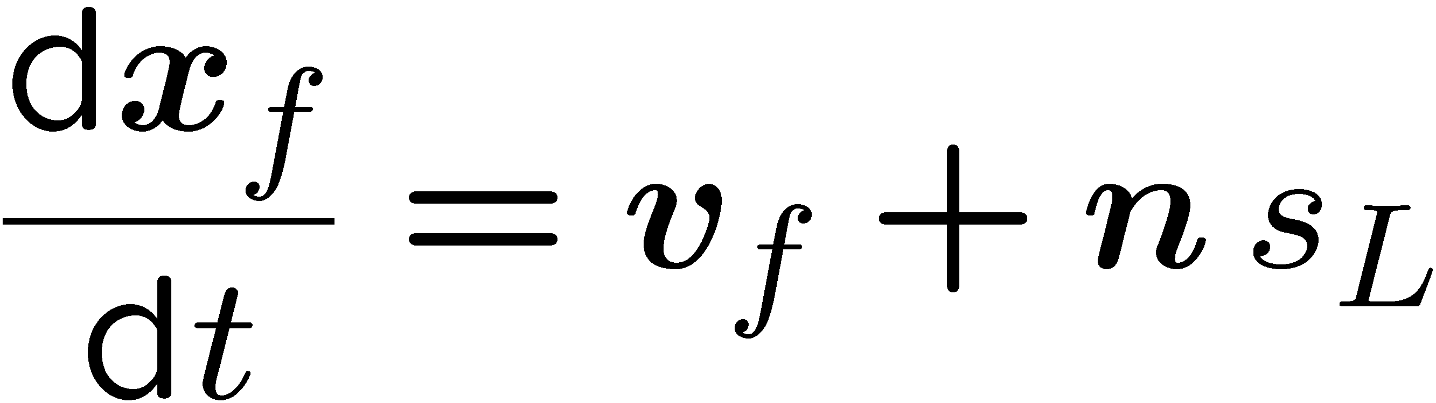
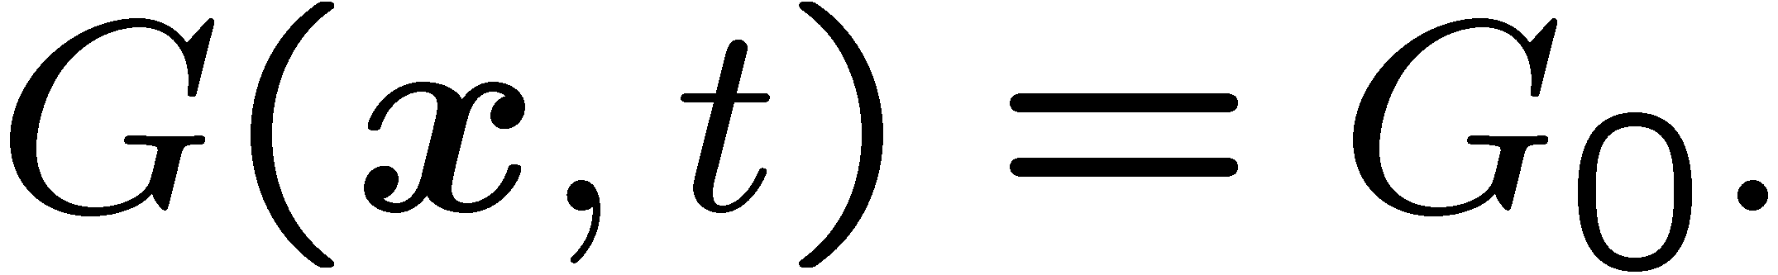
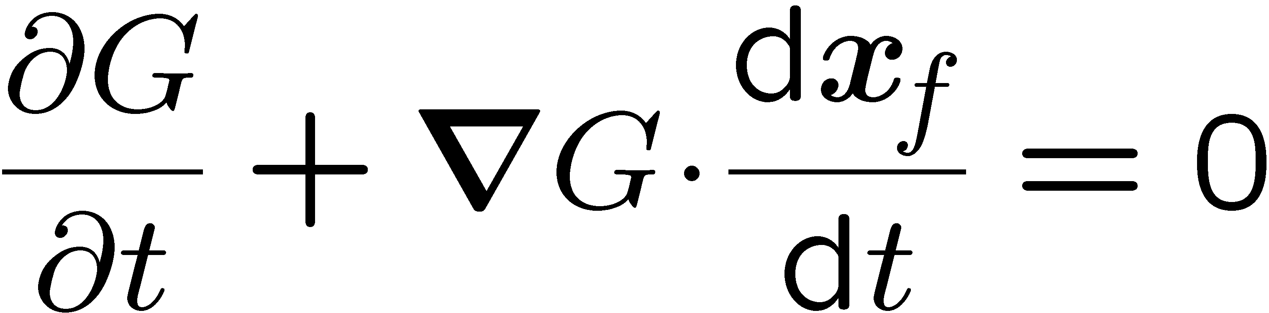
We introduce the vector normal to the front in direction of the unburnt gas, as by
In a general three-dimensional flow field the propagation velocity dv_{f}/dt of the front is equal to the sum of the flow velocity and the burning velocity in
normal direction
A field equation can now be derived by
differentiating
with respect to time
12.-3

Slide 4
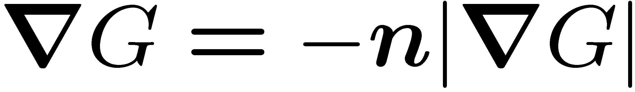
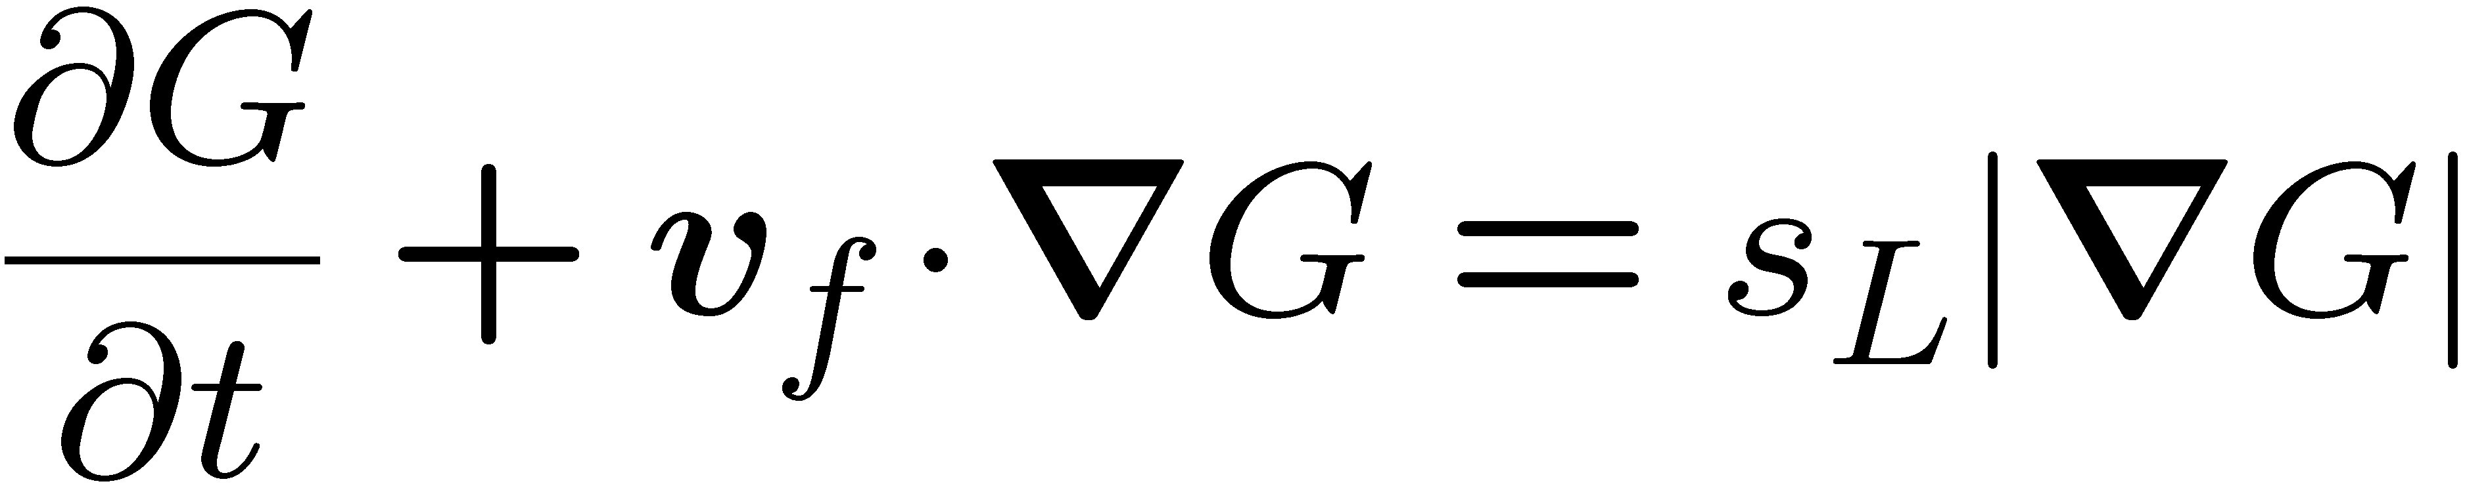
Introducing
and
one obtains the field equation
This equation was introduced by
Williams (1985) .
It is known as the G-equation.
12.-4

Slide 5
The G-equation is applicable to thin flame structures which propagate with a well-defined burning velocity.
It therefore is well-suited for the description of premixed turbulent combustion in the corrugated flamelets regime, where it is assumed that the laminar flame thickness is smaller than the smallest turbulent length scale, the Kolmogorov scale.
Therefore, the entire flame structure is embedded within a locally quasi-laminar flow field and the laminar burning velocity remains well-defined.
12.-5

Slide 6
The G-equation.
contains a local and a convective term on the l.h.s, a propagation term with the burning velocity s_{L} on the r.h.s but no diffusion term.
G is a scalar quantity which is defined at the flame surface only, while the surrounding G-field is not uniquely defined.
This originates simply from the fact that the kinematic balance
describes the motion of a point on a two-dimensional surface while the G-equation is an equation in three-dimensional space.
12.-6

Slide 7
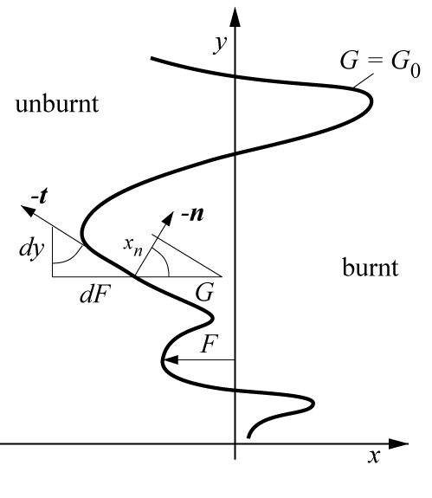
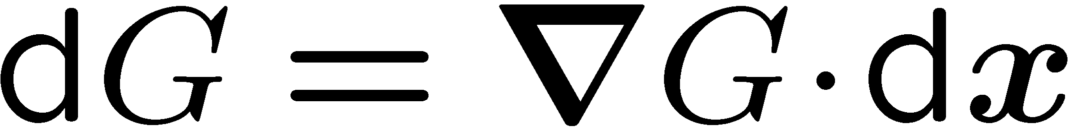
The value of σ value depends on the ansatz that is introduced in solving a particular problem using the G-equation.
For illustration purpose we choose
as ansatz for the G-field
Thereby the flame front displacement
F(y,z,t) is assumed to be a single-valued
function of y and z as shown for a
two-dimensional case.
This assumption does not allow for multiple crossings of the flame surface.
12.-7

Slide 8
Note that x is the co-ordinate normal to the
mean flame surface.
G is measured in x-direction.
It is also seen that the angle β between
the flame normal direction -n and the
x-axis is equal to the angle between
the tangential direction t and the
y-axis.
12.-8

Slide 9
In the corrugated flamelets regime the reactive-diffusive flame structure is
assumed to be thin compared to all length scales of the flow.
Therefore it may be approximated by jumps of temperature, reactants and products.
For such a very thin flame structure the iso-scalar surface G(x,t)=G₀ is often defined to lie in the unburnt mixture immediately ahead of the flame
structure.
12.-11

Slide 10
Since
was derived from
the velocity v_{f} and the burning velocity s_{L} are values defined at the surface G(x,t)=G₀.
In numerical studies values for these quantities must be assigned in the entire flow field.
The flow velocity v_{f} can simply be replaced by the local flow velocity v, a notation which we will adopt in the following.
12.-10

Slide 11
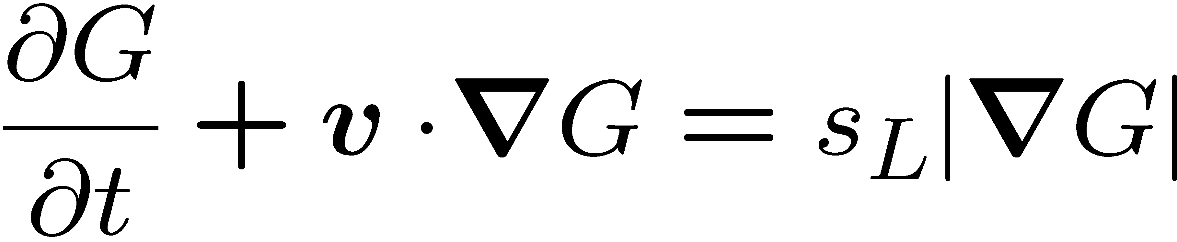
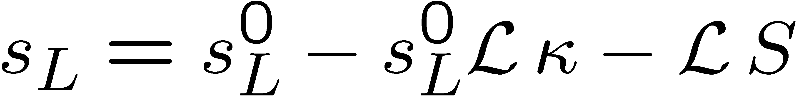
The burning velocity s_{L} appearing in
may be modified to account for the effect of flame stretch.
Performing two-scale asymptotic analyses of corrugated premixed flames, Pelce and Clavin (1982), Matalon and Matkowsky (1982) derived first order correction
terms for small curvature and strain.
The expression for the modified burning velocity becomes
12.-11

Slide 12
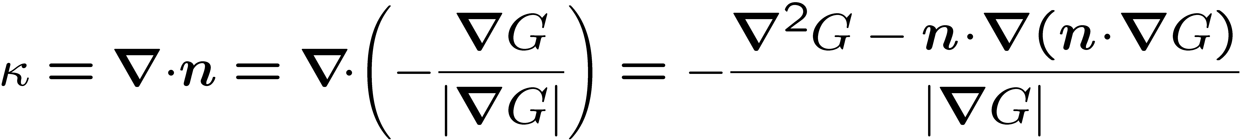
The expression for the modified burning velocity becomes
Here s_{L}⁰ is the burning velocity of the unstretched flame, κ is the curvature and
S is the strain rate.
The flame curvature is defined in terms of the G-field as
where
has been used. The flame curvature is positive if the flame is convex with respect to the unburnt mixture.
12.-12

Slide 13
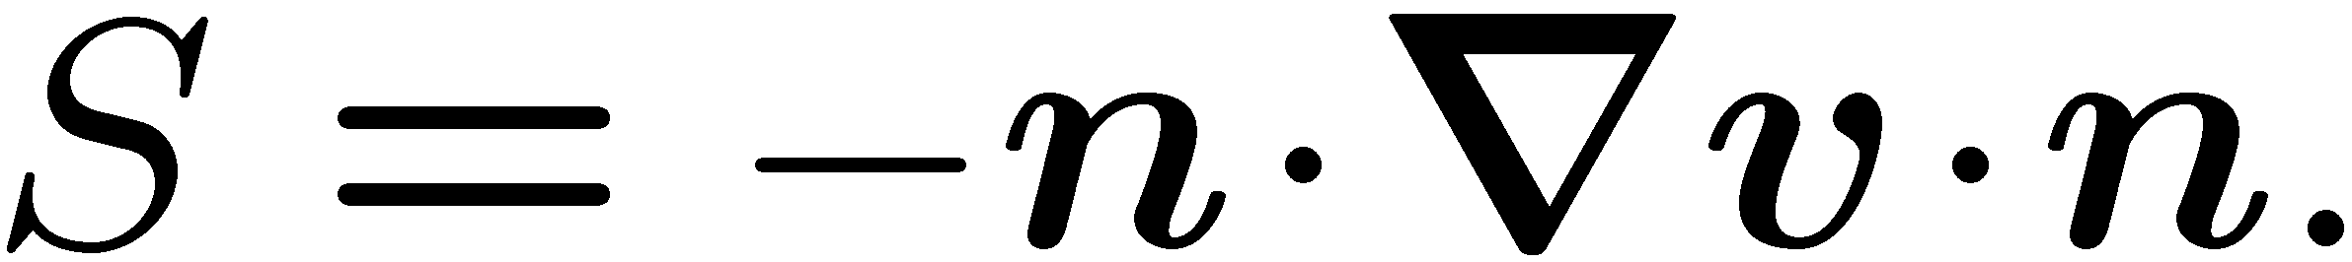

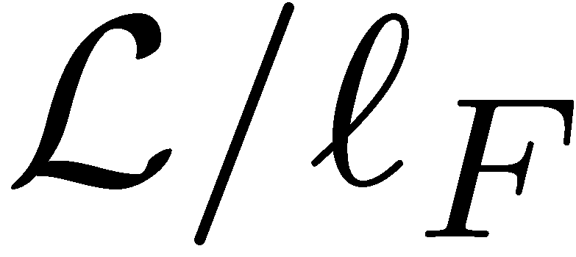
The strain rate imposed on the flame by velocity gradients is defined as
The Markstein length is of the same order of magnitude and proportional to the
laminar flame thickness.
The ratio is called the Markstein number.
12.-13

Slide 14
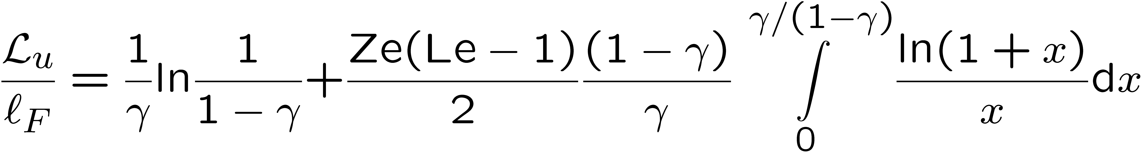
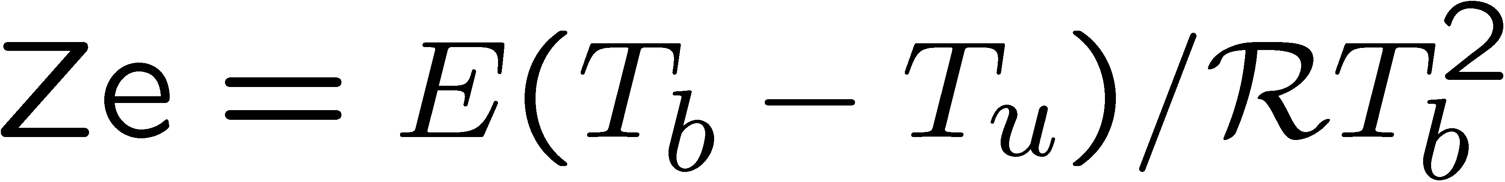
For the case of a one-step reaction with a large activation energy, constant transport properties and a constant heat capacity, the Markstein length with respect to the unburnt mixture reads, for example
This expression was derived by Clavin and Williams (1982) and
Matalon and Matkowsky (1982).
Here
is the Zeldovich number, where E is the activation energy, and Le is the
Lewis number of the deficient reactant.
12.-14

Slide 15
The Lewis number is approximately unity for methane flames and larger than unity for fuel-rich hydrogen and all fuel-lean hydrocarbon flames other than methane.
Therefore, since the first term on the r.h.s. of
is always positive, the Markstein length is positive for most practical applications of premixed hydrocarbon combustion, occuring typically under stoichiometric or fuel-lean conditions.
12.-15

Slide 16
Whenever the Markstein length is negative, as in lean hydrogen-air mixtures, diffusional-thermal instabilities tend to increase the flame surface area.
This is believed to be an important factor in gas cloud explosions of hydrogen-air
mixtures.
Although turbulence tends to dominate such local effects the combustion of
diffusional-thermal instabilities and instabilities induced by gas expansion could lead to strong flame accelerations.
12.-16

Slide 17
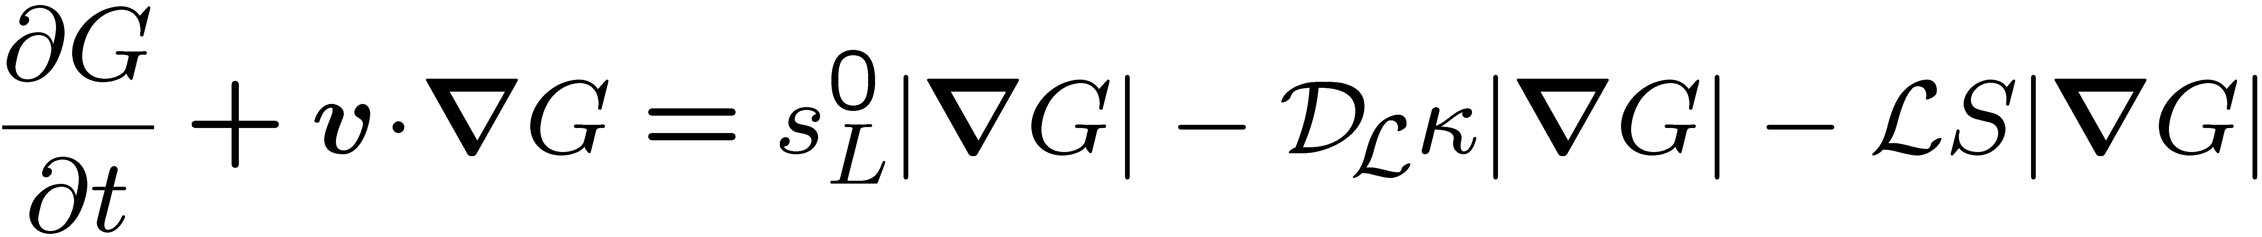
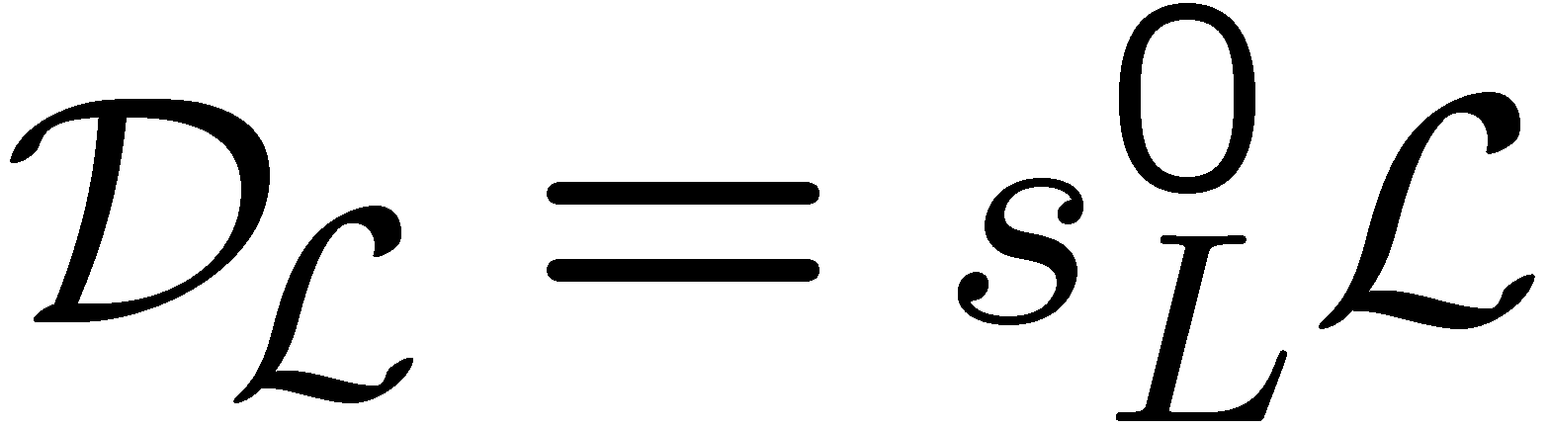
Introducing
into the G-equation it may be written as
Here
is defined as the Markstein diffusivity.
The curvature term adds a second order derivative to the G-equation.
12.-17

Slide 18
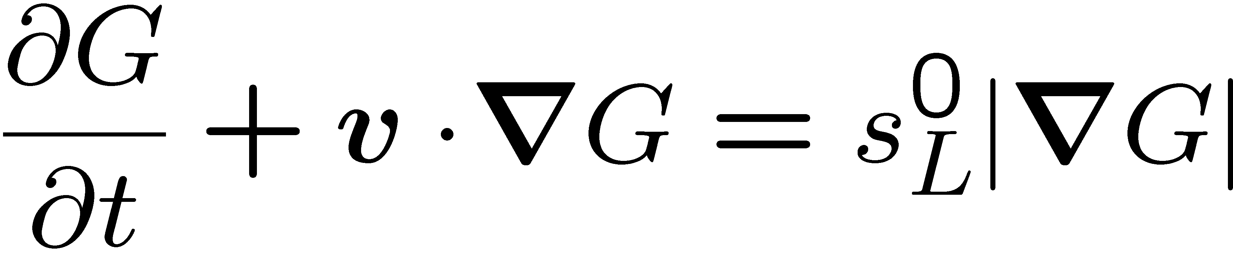
This avoids the formation of cusps that would result from
for a constant value of s_{L}⁰.
For positive Markstein length the mathematical nature of is that of a Hamilton-Jacobi equation with a parabolic second order differential operator coming from the curvature term.
While the solution of the G-equation with a constant s_{L}⁰ is solely determined by specifying the initial conditions, the parabolic character of
requires that the boundary conditions for each iso-surface G must be specified.
12.-18

Slide 19
The Level Set Approach for the Thin Reaction Zones Regime
The Eq.
is suitable for thin flame structures in the corrugated flamelets regime, where the entire flame structure is quasi-steady and the laminar burning velocity is well defined, but not for the thin reaction zones regime.
We now want to derive a level set formulation for the case, where the flame structure cannot be assumed quasi-steady because Kolmogorov eddies enter into the preheat zone and cause unsteady perturbations. The resulting equation will be valid in the thin reaction zones regime.
12.-19

Slide 20
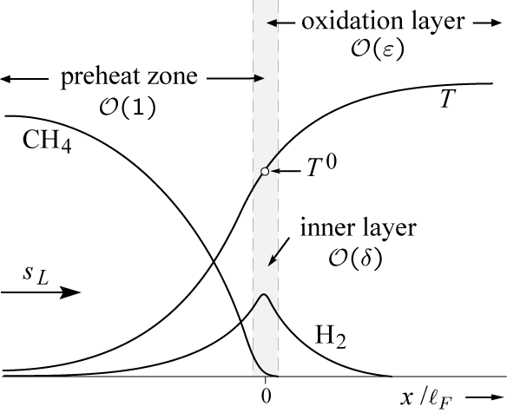
Since the inner layer shown previously is responsible for maintaining the
reaction process alive, we define the thin reaction zone as the inner layer.
The location of the inner layer
will be determined by the
iso-scalar surface
of the temperature setting
T(x,t)=T⁰, where T⁰ is the
inner layer temperature.
12.-20

Slide 21
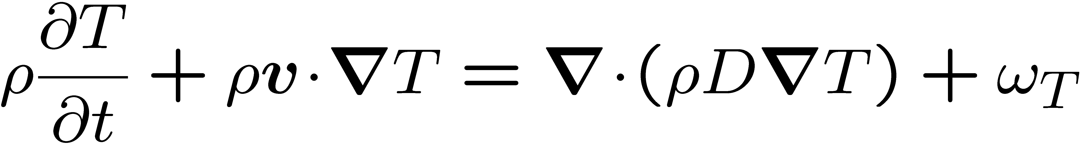
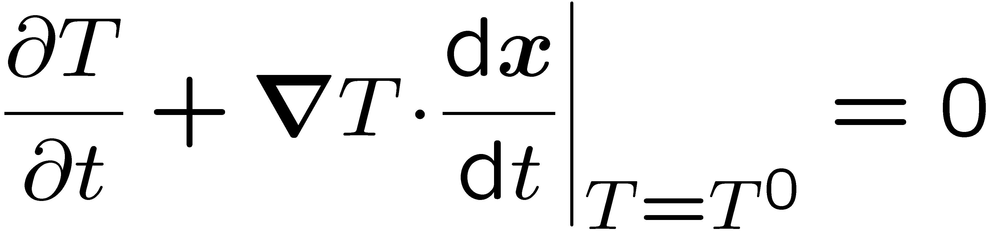
The temperature equation reads
where D is the thermal diffusivity ω_{T} the chemical source term.
Similar to Eq.
for the scalar G the iso-temperature surface T(x,t)=T⁰ satisfies the condition
12.-21

Slide 22
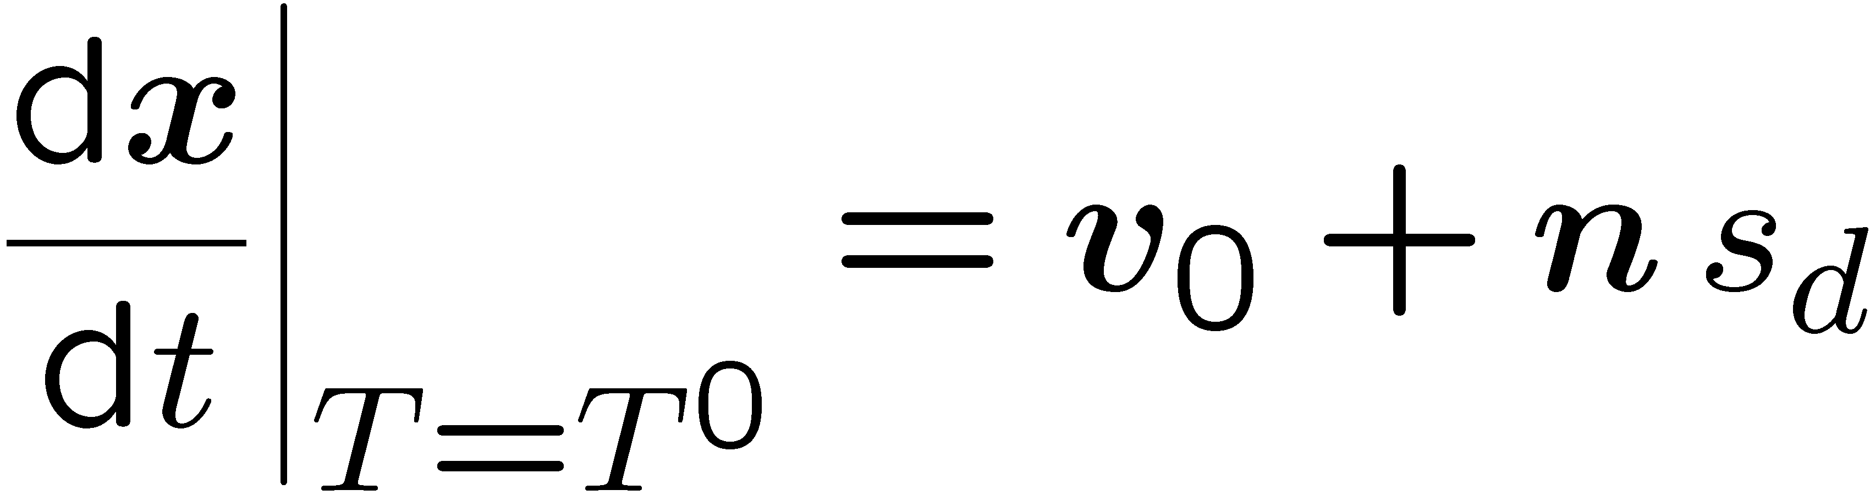
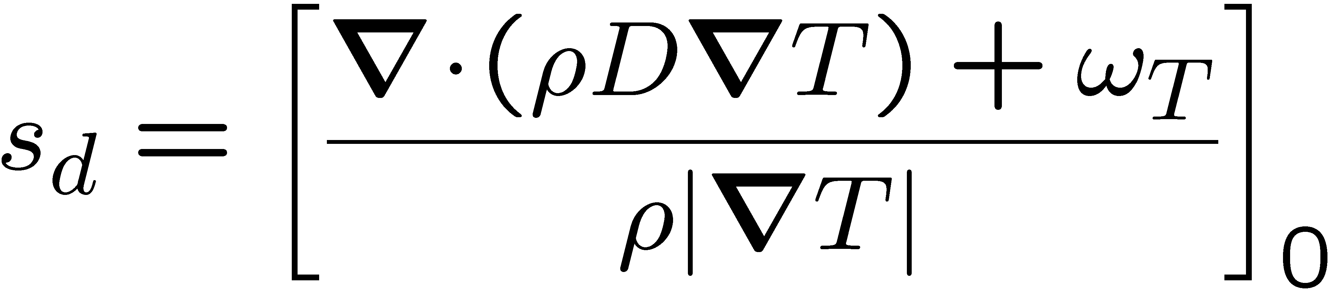
Gibson (1968) has derived an expression for the displacement speed s_{d} for an
iso-surface of non-reacting diffusive scalars.
Extending this result to the reactive scalar T this leads to
where the displacement speed s_{d} is given by
Here the index 0 defines conditions immediately ahead of the thin reaction zone.
12.-22

Slide 23
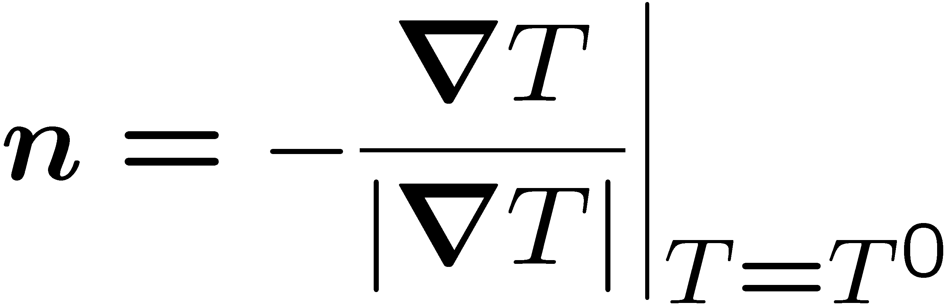
The normal vector on the iso-temperature surface is defined as
We want to formulate a G-equation that describes the location of the thin reaction
zones such that the iso-surface T(x,t)=T⁰ coincides with the iso-surface defined by G(x,t)=G⁰.
Then the normal vector defined by
is equal to that defined by
and also points towards the unburnt mixture.
12.-23

Slide 24
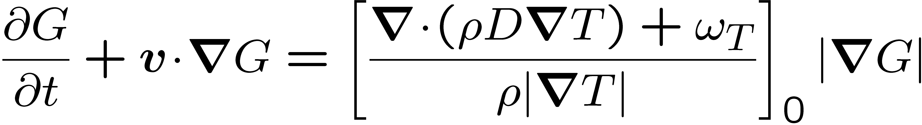
Using and
together with
leads the G-equation
12.-24

Slide 25
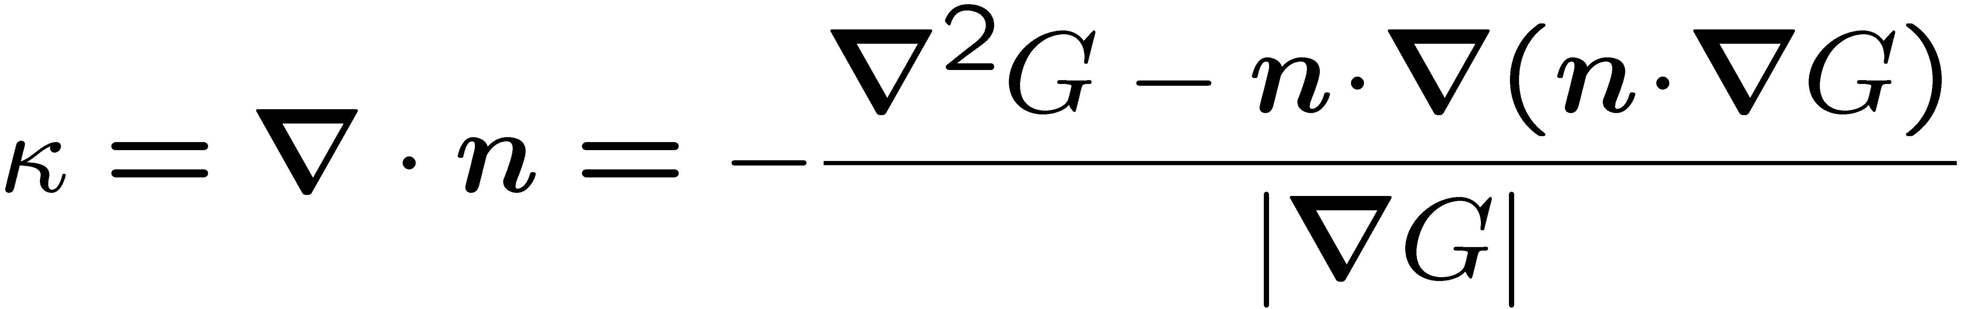
Peters et al. (1998) show that the diffusive term appearing in the brackets in this equation may be split into one term accounting for curvature and another for diffusion normal to the iso-surface
This is consistent with the definition of the curvature
if the iso-surface G(x,t)=G⁰ is replaced by the iso-surface T(x,t)=T⁰ and
if ρD is assumed constant.
12.-25

Slide 26
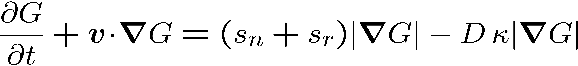
Introducing
into
one obtains
Here
is to be expressed by in terms of the G-field.
12.-26

Slide 27
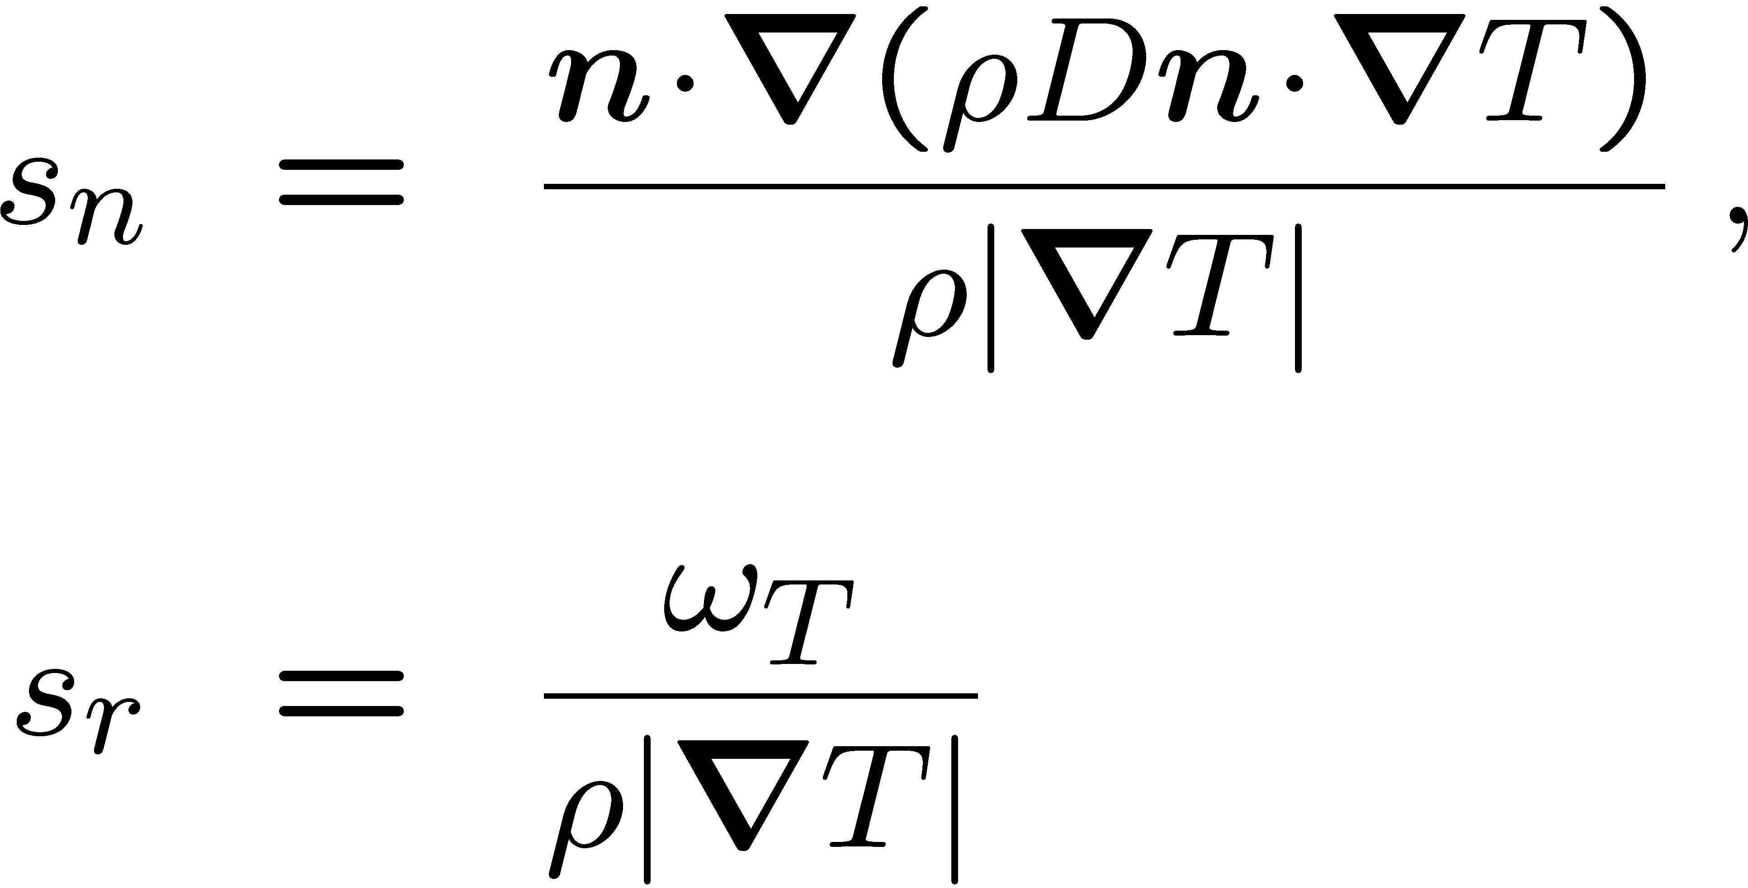
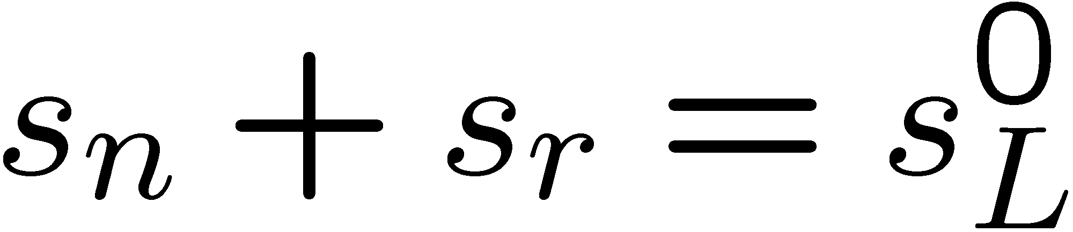
The quantities s_{n} and s_{r} are contributions due to normal diffusion and reaction to the displacement speed of the thin reaction zone and are defined as
In a steady unstretched planar laminar flame we would have
In the thin reaction zones regime, however, the unsteady mixing and diffusion of chemical species and the temperature in the regions ahead of the thin reaction zone will influence the local displacement speed.
12.-27

Slide 28
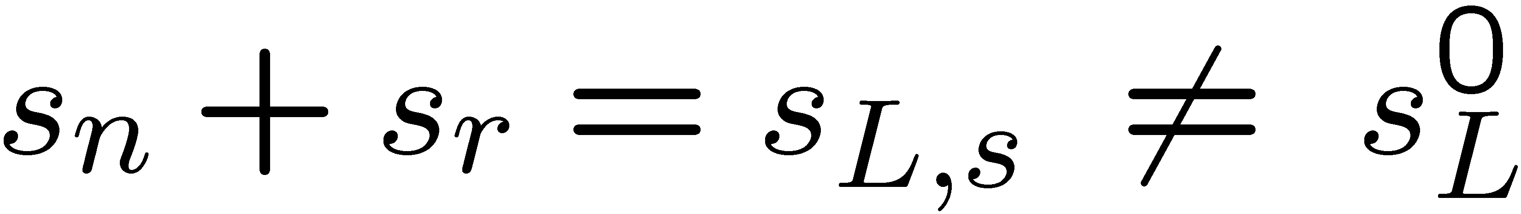
Then the sum of
is a fluctuating quantity that couples the G-equation to the solution of the balance equations of the reactive scalars.
There is reason to expect, however, that s_{L,s} is of the same order of magnitude as the laminar burning velocity.
The evaluation of DNS-data by Peters et al. (1998) confirms this estimate.
12.-28

Slide 29
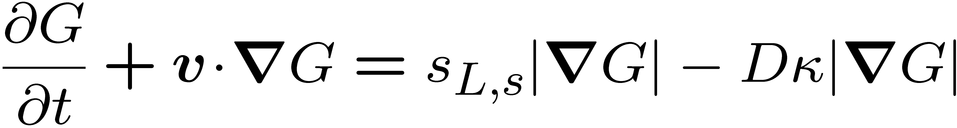
In that paper it was also found that the mean values of s_{n} and s_{r} slightly depend on curvature.
This leads to a modification of the diffusion coefficient which partly takes Markstein effects into account.
We will ignore these modifications here and consider the following level set equation for flame structures of
finite thickness
This equation is defined at the thin reaction zone.
v, s_{L,s}, and D are values at that position.
12.-29

Slide 30

is very similar to
which was derived for thin flame structures in the corrugated flamelets regime.
An important difference is the difference between and D and the disappearance of the strain term.
The latter is implicitly contained in the burning velocity s_{L,s}.
12.-30

Slide 31
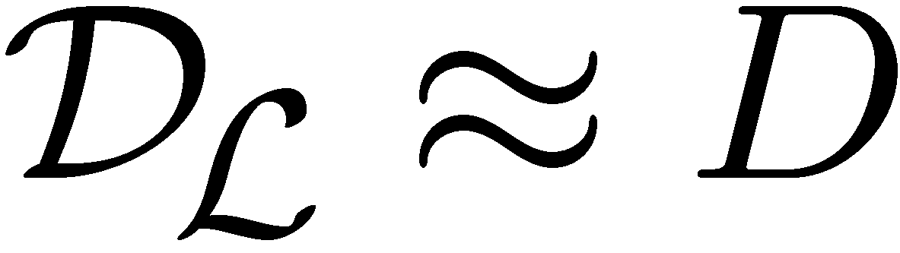
In an analytical study of the response of one-dimensional constant density flames to time-dependent strain and curvature, Joulin (1994) has shown that
in the limit of high frequency perturbations the effect of strain disappears entirely and Lewis-number effects also disappear in the curvature term such that
This analysis was based on one-step large activation energy asymptotics with the assumption of a single thin reaction zone.
12.-31

Slide 32
It suggests that
could also have been derived from
for the limit of high frequency perturbations of the flame structure.
This strongly supports it as level set equation for flame structures of finite thickness and shows that unsteadiness of that structure is an important feature in the thin reaction zones regime.
12.-32

Slide 33
The important difference between the level set formulation
and the equation for the reactive scalar
is the appearance of a burning velocity which replaces normal diffusion and reaction at the flame surface.
12.-33

Slide 34
It should be noted the level set equations
and
are only defined at the flame surface,
while
is valid in the entire field.
12.-34

